Slide 1
COMP 2000
Week 14 - Friday

Slide 2
Last time
What did we talk about last time?
Review up to Exam 2
  Java GUIs
    JOptionPane
    JFrame
    Widgets
    Layout managers
    Action listeners
  Recursion
  Files
    Text I/O
    Binary I/O
    Serialization
  Networking

Slide 3
Questions?

Slide 4
Project 4

Slide 5
Final exam
Final exam will be held virtually:
  Monday, April 27, 2020
  10:15 a.m. to 12:15 p.m.
There will be multiple choice, short answer, and programming questions
I recommend that you use an editor like Notepad++ to write your answers, since Blackboard doesn't play nice with tabs
I don't recommend that you use Eclipse, since the syntax highlighting features will make you doubt yourself and try to get things perfect when getting them done is more important

Slide 6
Review after Exam 2

Slide 7
Dynamic Data Structures

Slide 8
Linked list
A linked list is one of the simplest kinds of dynamic data structures
You can imagine a linked list as a train
Each node in the linked list has some cargo, and it can point at the next item in the list
The last item points at null so that you know that the train has ended
You can add and remove nodes as much as you want, and nothing needs to be resized

Slide 9
Doubly linked list
The most common library implementation of a linked list is a doubly linked list
Node consists of data, a next pointer, and a previous pointer
Because we know the next and the previous, we can move forwards or backwards in the list
X
head
23
47
58
X
tail

Slide 10
Definition
Simple definition for a doubly-linked list that holds an unlimited number of String values:
public class LinkedList {
private static class Node {
public String data;
public Node next;
public Node previous;
}
private Node head = null
private Node tail = null;
private int size = 0;
…
}

Slide 11
Containers
When you write a container class (like a list), you have to write it to contain something
  A list of String values
  A list of Wombat values
  A list of int values
What if we could design a list class and not specify what its contents are?
Someone has to say what it contains only when they make a particular list

Slide 12
Generics
That's the idea behind generics in Java
  The name is because it lets you make a generic list instead of a specific kind of list
You can make classes (often, but not always, containers)
These classes have one or more type parameters
The type parameters are like variables that hold type information
When you make such an object, you have to say what its types are

Slide 13
Angle brackets
Influenced by templates in C++, Java puts type parameters in angle brackets ( <> )
For example, we can declare the following LinkedList objects defined in the Java Collections Framework
For technical reasons, you can only use reference types for type parameters, never primitive types
LinkedList<String> words = new LinkedList<String>();
LinkedList<Wombat> zoo = new LinkedList<Wombat>();
LinkedList<Integer> numbers = new LinkedList<Integer>();

Slide 14
Boxing and unboxing
If you use the wrapper class as the type parameter, Java will automatically convert primitive types to and from the wrapper class
This is called boxing and unboxing
For example:
For the most part, it magically works
However, storing primitive types is less efficient
LinkedList<Integer> numbers = new LinkedList<>();
numbers.add(7);
numbers.add(15);
int value = numbers.get(0); // Holds 7

Slide 15
Type parameter syntax
When declaring a generic class, put angle brackets and the type parameter after the name of the class
The type parameter is often called T, standing for type
Consider a simple generic class that holds a pair of…anything
public class Pair<T> {
private T x;
private T y;
public Pair(T x, T y) {
this.x = x;
this.y = y;
}
}

Slide 16
Definition
Instead of String values, we can write a doubly linked list class that holds anything
public class LinkedList<T> {
private static class Node<T> {
public T data;
public Node<T> next;
public Node<T> previous;
}
private Node<T> head = null
private Node<T> tail = null;
private int size = 0;
…
}

Slide 17
Java Collections Framework

Slide 18
Container interfaces
Collection Parent interface of most containers
Iterable A collection that can be iterated over
List A collection that contains items in an order
Queue A collection that supports FIFO operations
Set A collection of unordered objects
Map A collection of (key, value) pairs

Slide 19
Container classes
LinkedList List implementation using a linked list
ArrayList List implementation using a dynamic array
Stack FILO data structure
Vector Like an ArrayList, but thread-safe
HashSet Set implementation using a hash table
TreeSet Set implementation using binary search trees
HashMap Map implementation using a hash table
TreeMap Map implementation using binary search trees

Slide 20
Tools
Collections
  sort()
  max()
  min()
  replaceAll()
  reverse()
Arrays
  binarySearch()
  sort()

Slide 21
List<E> methods
The List<E> interface is one of the biggest you'll ever see
Here are a few important methods in it
Returns | Method | Description
boolean | add(E element) | Adds element to the end of the list
void | add(int index, E element) | Adds element before index
boolean | addAll(Collection<? extends E> collection) | Adds everything from collection to this list
void | clear() | Removes everything from this list
boolean | contains(Object object) | Returns true if this list contains object
E | get(int index) | Return the element at index
int | indexOf(Object object) | Returns the first index where something that equals object can be found
boolean | isEmpty() | Returns true if the list is empty
boolean | remove(int index) | Remove the element at index
E | set(int index, E element) | Set the item at location index to element
int | size() | Returns the size of the list

Slide 22
ArrayList vs. LinkedList
As you will learn (or have learned) in COMP 2100, ArrayList uses an array inside to store datay
  When you need more space, it makes a new array and copies all the old stuff into the new array
LinkedList uses a (wait for it) linked list to store the data
In principle, LinkedList is faster for lots of unpredictable adds and removals
  Especially adds and removals at the beginning of the list
In practice, ArrayList is almost always faster
  Modern machines are really good at ripping through arrays

Slide 23
Maps
Maps are a kind of data structure that holds a (key, value) pair
For example, a map might use social security numbers as keys and have Person objects as the value
In a map, the keys must be unique, but the values could be repeated
Both Java and C++ use the name map for the symbol table classes in their standard libraries
Python calls it a dictionary (and supports it in the language, not just in libraries)
Maps are also called symbol tables

Slide 24
Concrete example
Maps are for you can imagine storing as data with two columns, a key and a value
In this way you can look up the weight of anyone
However, the keys must be unique
  Ahmad and Carmen might weigh the same, but Ahmad cannot weight two different values
There are multimaps in which a single key can be mapped to multiple values
  But they are used much less often
  All you really need is a map whose values are lists
Name (Key) | Weight (Value)
Ahmad | 210
Bai Li | 145
Carmen | 105
Deepak | 175
Erica | 205

Slide 25
JCF Map
The Java interface for maps is, unsurprisingly, Map<K,V>
  K is the type of the key
  V is the type of the value
  Yes, it's a container with two generic types
Any Java class that implements this interface can do the important things that you need for a map
  get(Object key)
  containsKey(Object key)
  put(K key, V value)

Slide 26
JCF implementation
Because the Java gods love us, they provided two main implementations of the Map interface
HashMap<K,V>
  Hash table implementation
  To be useful, type K must have a meaningful hashCode() method
TreeMap<K,V>
  Balanced binary search tree implementation
  To work, type K must implement the compareTo() method
  Or you can supply a comparator when you create the TreeMap

Slide 27
JCF Set
Java also provides an interface for sets
A set is like a map without values (only keys)
All we care about is storing an unordered collection of things
The Java interface for sets is Set<E>
  E is the type of objects being stored
Any Java class that implements this interface can do the important things that you need for a set
  add(E element)
  contains(Object object)

Slide 28
JCF implementation
As with maps, there are two main implementations of the Set interface
HashSet<E>
  Hash table implementation
  To be useful, type E must have a meaningful hashCode() method
TreeSet<E>
  Balanced binary search tree implementation
  To work, type E must implement the compareTo() method
  Or you can supply a comparator when you create the TreeSet

Slide 29
Sorting

Slide 30
Sorting arrays
Every language has its own libraries for sorting
Let's start with sorting arrays
It would be nice if every array just had a sort() method
  But it doesn't!
Instead, there's an Arrays (note the s) class with a number of useful static methods (with versions for arrays of every primitive type as well as Object):
  sort()
  binarySearch()
  toString()
To use it, import java.util.Arrays

Slide 31
Array sorting example
Calling Arrays.sort() will sort arrays of byte, char, short, int, long, float, double, and String, always in ascending order
Calling Arrays.toString() also produces a nice printable version of an array
// Obviously, data could also be input from the user or file
int[] numbers = {98, 50, 25, 30, 10, 56, 79, 86, 18, 92};
Arrays.sort(numbers);
// Output: [10, 18, 25, 30, 50, 56, 79, 86, 92, 98]
System.out.println(Arrays.toString(numbers));
String[] words = {"The", "quick", "brown", "fox", "jumps", "over", "the", "lazy", "dog"};
Arrays.sort(words);
// Output: [The, brown, dog, fox, jumps, lazy, over, quick, the]
// Don't forget that uppercase letters have lower ASCII values
System.out.println(Arrays.toString(words));

Slide 32
Sorting other collections
If you're sorting a collection (meaning List, LinkedList, ArrayList, Vector, etc.), you can use Collections.sort()
When a collection has its own sort() method (as ArrayList does), use that, since it's tuned for performance on that collection
Scanner file = new Scanner(new File(fileName));
LinkedList<String> words = new LinkedList<>();
while(file.hasNext())
words.add(file.next());
file.close();
// Print out all the words in the file, sorted
Collections.sort(words);
for(String word : words)
System.out.println(word);

Slide 33
Comparable<T>
If you want to sort an array or a list of some object, it must implement the Comparable<T> interface, where T is usually the type of the object itself
The Comparable<T> interface has one method in it:
An object that implements Comparable<T> will return:
  A negative number if it comes before other in order
  A positive number if it comes after other in order
  Zero if it is equivalent to other
It's usually not important what the values are, just whether they are positive or negative
int compareTo(T other);

Slide 34
Wombat example
Wombat's are prized for their cuddliness, so we want to compare them by how fat they are
By subtracting the other Wombat object's weight from our own, we get negative if we're smaller, positive if we're bigger, and zero if we weigh the same
public class Wombat implements Comparable<Wombat> {
private int weight;
private String name;
public Wombat(String name, int weight) {
this.name = name;
this.weight = weight;
}
public int compareTo(Wombat other) {
return weight - other.weight;
}
public int String getName() {
return name;
}
}

Slide 35
What if things weren't designed to be sorted?
What if the objects you're working with don't implement the Comparable interface?
Or if you want to sort them in some other way?
You can supply a custom Comparator<T> object to the sort() methods that will say how they should be compared
The Comparator<T> interface contains one method you have to implement:
It should return negative if a comes before b, positive if a comes after b, and zero if a and b are equivalent
int compare(T a, T, b);

Slide 36
Planet example
Here's a simple class for Planet, a class they didn't expect to sort
public class Planet {
private String name;
private double radius;
public Planet(String name, double radius) {
this.name = name;
this.radius = radius;
}
public double getRadius() {
return radius;
}
public String getName() {
return name;
}
}

Slide 37
Sorting Planet objects by radius
Since the Planet class doesn't implement Comparable, we have to make a Comparator to pass to the sort() method
We have to make an anonymous inner Comparable class, using the Double.compare() method to help use order by radius
List<Planet> planets = new ArrayList<>();
planets.add(new Planet("Venus", 6051.8));
planets.add(new Planet("Earth", 6371.0));
planets.add(new Planet("Mars", 3389.5));
Comparator<Planet> comparator = new Comparator<Planet>() {
int compare(Planet a, Planet b) {
return Double.compare(a.getRadius(), b.getRadius());
}
};
Collections.sort(planets, comparator);
// Order: Mars, Venus, Earth

Slide 38
Sorting Planet objects in Java 8
Using Java 8 style, we could also create the Comparator object with the quicker (but slightly more confusing) -> syntax
List<Planet> planets = new ArrayList<>();
planets.add(new Planet("Venus", 6051.8));
planets.add(new Planet("Earth", 6371.0));
planets.add(new Planet("Mars", 3389.5));
// Order: Mars, Venus, Earth
Collections.sort(planets, (a, b) -> Double.compare(a.getRadius(), b.getRadius()));

Slide 39
UML

Slide 40
UML
The Unified Modeling Language (UML) is an international standard for graphical models of software systems
A few useful kinds of diagrams:
  Activity diagrams
  Use case diagrams
  Sequence diagrams
  State diagrams
Class diagrams are important enough that we'll talk about them in greater detail

Slide 41
Activity diagrams
Activity diagrams show the workflow of actions that a system takes
Formally:
  Rounded rectangles represent actions
  Diamonds represent decisions
  Bars represent starting or ending concurrent activities
  A black circle represents the start
  An encircled black circle represents the end

Slide 42
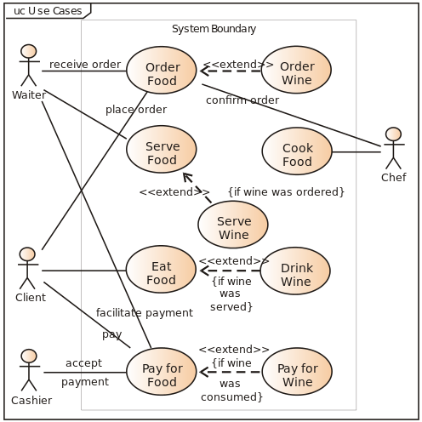
Use case diagrams
Use case diagrams show relationships between users of a system and different use cases where the user is involved
Example from Wikipedia:

Slide 43
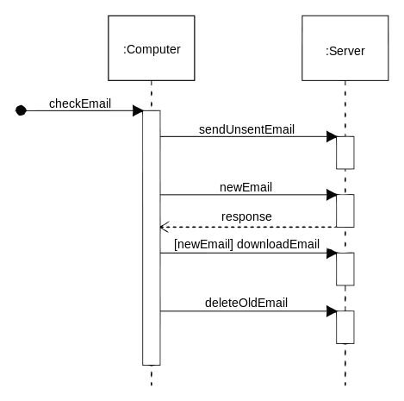
Sequence diagrams
Sequence diagrams show system object interactions over time
These messages are visualized as arrows
  Solid arrow heads are synchronous messages
  Open arrow heads are asynchronous messages
  Dashed lines represent replies
Example from Wikipedia:

Slide 44
State diagrams
State diagrams are the UML generalization of finite state automata from discrete math
They describe a series of states that a system can be in and how transitions between those states happen

Slide 45
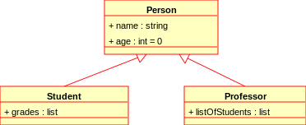
Class diagrams
Class diagrams show many kinds of relationships
The classes being described often (but not always) map to classes in object-oriented languages
The following symbols are used to mark class members:
  + Public
  - Private
  # Protected
  / Derived
  ~ Package
  * Random
Example from Wikipedia:

Slide 46
Testing

Slide 47
Purposes of testing
There are two almost opposing purposes for testing
Showing that software meets its requirements
  Validation testing
  Looking for good outputs
Finding inputs where software doesn't work
  Defect testing
  Looking for bad outputs
When a project is due, students often confuse the two
  Trying to convince themselves that the code is fine instead of looking for problems

Slide 48
Stages of testing
Commercial software systems often go through three stages of testing
Development testing
  Look for bugs during development
  Designers and programmers do the testing
Release testing
  Test a complete version of the code to see if it meets requirements
  A separate testing team does the testing
User testing
  Users test the system in a real environment
  Acceptance testing is a special kind of user testing to decide whether or not the product should be accepted or sent back

Slide 49
Development testing
Development testing is the idea of testing you're most familiar with
  Testing the software as it's being developed
  Development testing is focused on defect testing
  Debugging happens alongside development testing
Three stages of development testing:
  Unit testing: testing individual classes or methods
  Component testing: testing components made from several objects
  System testing: testing the system as a whole

Slide 50
Unit testing
Unit testing focuses on very small components
  Methods or functions
  Objects
Unit tests try many different inputs for the methods or objects to make sure that the outputs match

Slide 51
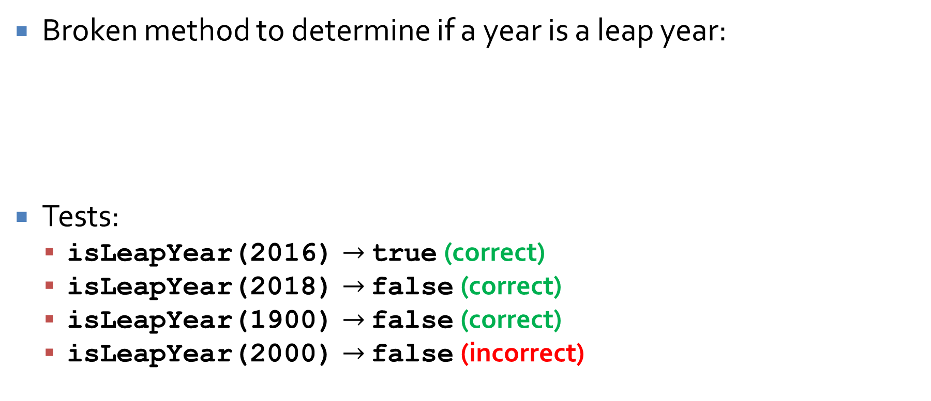
Unit test example
Broken method to determine if a year is a leap year:
Tests:
  isLeapYear(2016) $→$ true (correct)
  isLeapYear(2018) $→$ false (correct)
  isLeapYear(1900) $→$ false (correct)
  isLeapYear(2000) $→$ false (incorrect)
public static boolean isLeapYear(int year) {
return year % 4 == 0 && year % 100 != 0;
}

Slide 52
Black box testing
One philosophy of testing is making black box tests
A black box test takes some input A and knows that the output is supposed to be B
It assumes nothing about the internals of the program, only the specification
To write black box tests, you come up with a set of input you think covers lots of cases and you run it and see if it works
In the real world, black box testing can easily be done by a team that did not work on the original development

Slide 53
White box testing
White box testing is the opposite of black box testing
  Sometimes white box testing is called "clear box testing"
In white box testing, you can use your knowledge of how the code works to generate tests
Are there lots of if statements?
  Write tests that go through all possible branches
There are white box testing tools that can help you generate tests to exercise all branches
Which is better, white box or black box testing?

Slide 54
Component testing
Beyond unit testing is component testing
Components are made up of several independent units
The errors are likely to be from interactions between the units
  Hopefully, the individual units have already been unit tested
The interfaces between the units have to be tested
  Parameter interfaces in method calls
  Shared memory interfaces
  Procedural interfaces in which an object implements a set of procedures
  Message passing interfaces

Slide 55
System testing
System testing is when we integrate components together in a version of the whole system
Though similar to component testing, there are differences:
  Older reusable components and commercial components might be integrated with new components
  Components developed by different teams might be integrated for the first time
Sometimes, you only see certain behavior when you get everything together
Try testing all the use cases you expect the system to see

Slide 56
JUnit

Slide 57
JUnit
JUnit is a popular framework for automating the unit testing of Java code
JUnit is built into Eclipse and many other IDEs
It is possible to run JUnit from the command line after downloading appropriate libraries
JUnit is one of many xUnit frameworks designed to automate unit testing for many languages
You are required to make JUnit tests for Project 4
JUnit 5 is the latest version of JUnit, and there are small differences from previous versions

Slide 58
JUnit classes
For each set of tests, create a class
Code that must be done ahead of every test has the @BeforeEach annotation
Each method that does a test has the @Test annotation
import org.junit.jupiter.api.*;
public class Testing {
private String creature;
@BeforeEach
public void setUp() {
creature = "Wombat";
}
@Test
public void testWombat() {
Assertions.assertEquals("Wombat", creature, "Wombat failure");
}
}

Slide 59
Assertions in JUnit tests
When you run a test, you expect to get a certain output
You should assert that this output is what it should be
JUnit 5 has a class called Assertions that has a number of static methods used to assert that different things are what they should be
  Running JUnit takes care of turning assertions on
The most common is assertEquals(), which takes the expected value, the actual value, and a message to report if they aren't equal:
  assertEquals(int expected, int actual, String message)
  assertEquals(char expected, char actual, String message)
  assertEquals(double expected, double actual, double delta, String message)
  assertEquals(Object expected, Object actual, String message)
Another useful method in Assertions:
  assertTrue(boolean condition, String message)

Slide 60
Assertion example
We know that the substring() method on String objects works, but what if we wanted to test it?
import org.junit.jupiter.api.*;
public class StringTest {
@Test
public void testSubstring() {
String string = "dysfunctional";
String substring = string.substring(3,6);
Assertions.assertEquals("fun", substring, "Substring failure!");
}
}

Slide 61
Test driven development
Test driven development (TDD) is an approach to development where testing and coding are interleaved
Never move to the next increment of code until the current one passes its tests
The key idea of TDD is that you write tests for the code before you write the code

Slide 62
Benefits of TDD
By making the test first, you really understand what you're trying to implement
Your testing has better code coverage, testing every segment of code at least once
Regression testing happens naturally
Debugging should be easier since you know where the problem likely is (the new code added)
The tests are a form of documentation, showing what the code should and shouldn't do

Slide 63
Practice questions
Write a doubly-linked list class containing String values that can add to and remove from the front and the back
Convert that doubly-linked list class to a generic class holding values of type T
Write a Tuna class that implements Comparable<Tuna>, based on a weight member variable
Write a custom comparator to sort a list of double values in descending order (largest values first)
What's the difference between black box testing and white box testing?

Slide 64
Upcoming

Slide 65
Next time…
There is no next time!

Slide 66
Reminders
Finish Project 4
  Due tonight by midnight!
Review chapters 7, 10-12, and , 15-21 and notes
Look over labs, quizzes, and projects to prepare
Final Exam:
  Monday, April 27, 2020
  10:15 a.m. to 12:15 p.m.

